Slide 1
CZ4052 Cloud Computing Project
Group Member: Chua Zi Jian (U2022354J)

Slide 2
Content
Introduction
Problem Statement & Solution Design
Programming Tools
Website Development
Conclusion

Slide 3
Introduction

Slide 4

Introduction
E-commerce market has been expanding significantly
Exponential growth of e-commerce
E-commerce has become a modern way of purchasing item

Slide 5
Problem Statement & Solution Design

Slide 6

Problem Statement
Traditional method of tracking customer info lack integration
Sales data analysis and monitoring of affiliate performance lack real-time insights

Slide 7
Solution Design
Introducing E-commerce Dashboard website
Able to access real-time data from any devices
Empower businesses with actionable insights and streamlined management capabilities
Sales
Income
Damage
$125,500
$246,301
$50,618
Dashboard
Sales
My task
Calendar
Income
Portfolios
Inbox
Damage
Work list
Setting

Slide 8
Essential Functions of Website
Customer Information Management
Products Rating and Review
Transaction History
Geographics Insights
Revenue and Profit Overview
Sales Analytics
Product Category Breakdown
Admin Management
Affiliate Sales Performance
E-commerce Report Export

Slide 9
Programming Tools

Slide 10

Programming Tools
MERN stack is used for website development
MERN stands for MongoDB, Express.js, React.js and Node.js
Javascript-based technology stack
If one knows JavaScript (and JSON), the backend, frontend, and database can be operated easily

Slide 11

Vercel
Vercel Inc., formerly ZEIT, is an American cloud platform as a service company
Allows user to deploy projects easily
Integrates directly with GitHub

Slide 12
Website Development

Slide 13
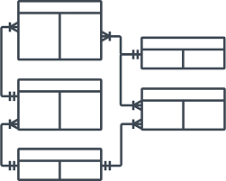
ER Diagram
Used to represent the E-R model in a database, which makes them easy to convert into relations (tables)
Provide the purpose of real-world modeling of objects which makes them intently useful.
Very easy to understand and easy to create even for a naive user.

Slide 14
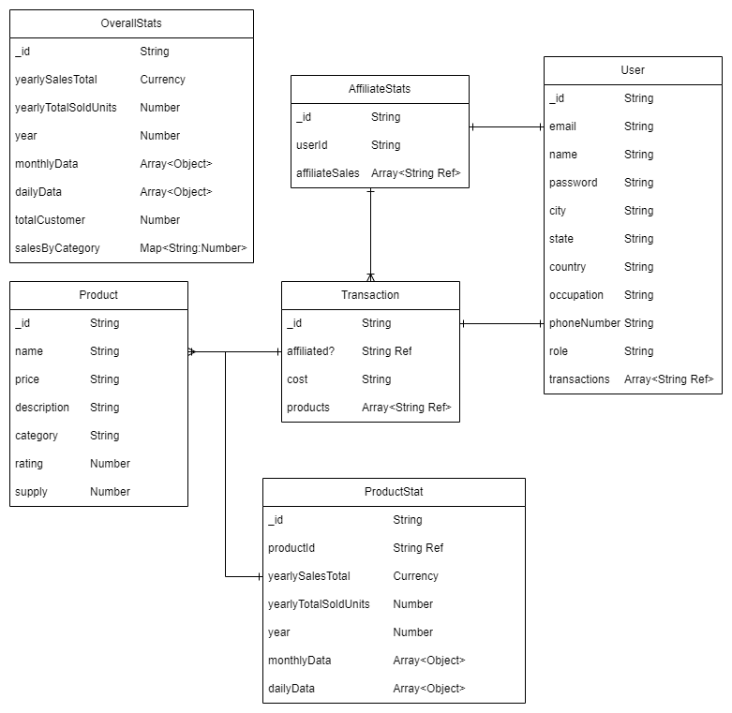
ER Diagram

Slide 15
ER Diagram
Relationship between each Entity:
One-to-One Relation:
User -> AffiliateStats (key: _id -> userId)
User -> Transaction (key: _id -> _id)
Product -> ProductStat (key: _id -> productId)
One-to-Many Relation
AffiliateStats -> Transaction (key: _id -> affiliated)
Transaction -> Product (key: products -> _id)

Slide 16
UI Design
Used to represent the E-R model in a database, which makes them easy to convert into relations (tables)
Provide the purpose of real-world modeling of objects which makes them intently useful.
Very easy to understand and easy to create even for a naive user.

Slide 17
UI Design
Pages Available in our Website:
Landing Page
Dashboard Page
Products Page
Customers Page
Transactions Page
Geography Page
7. Overview Page
8. Daily Page
9. Monthly Page
10. Breakdown Page
11. Admin Page
12. Performance Page

Slide 18

UI Design
Landing Page

Slide 19
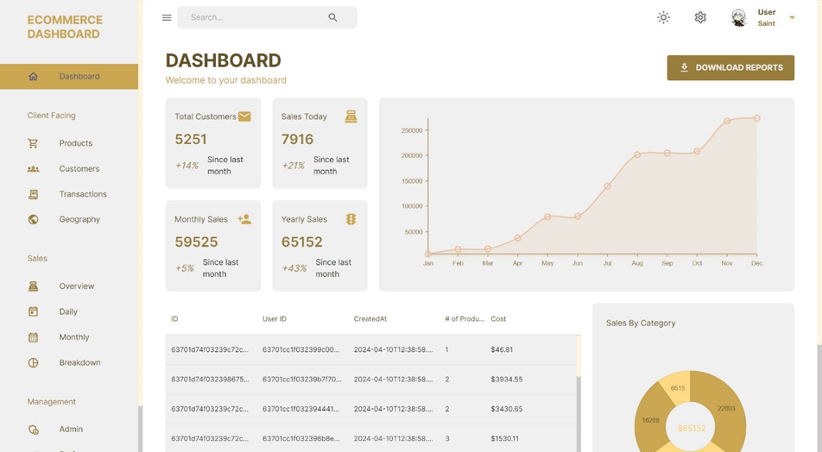
UI Design
Dashboard Page

Slide 20
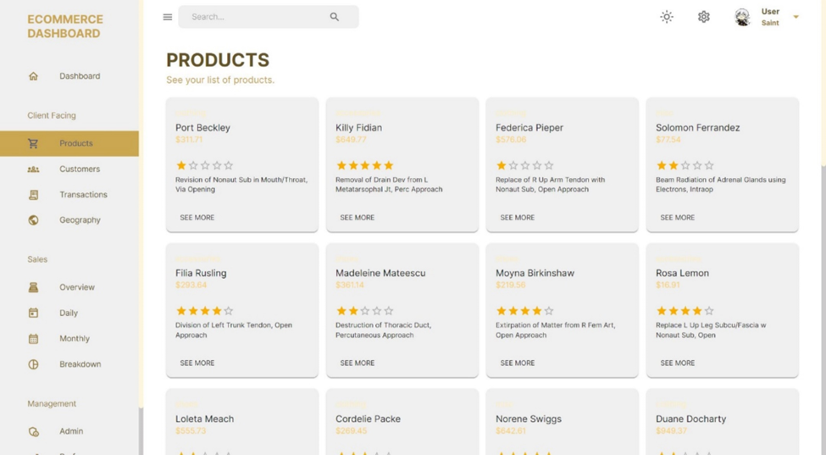
UI Design
Products Page

Slide 21
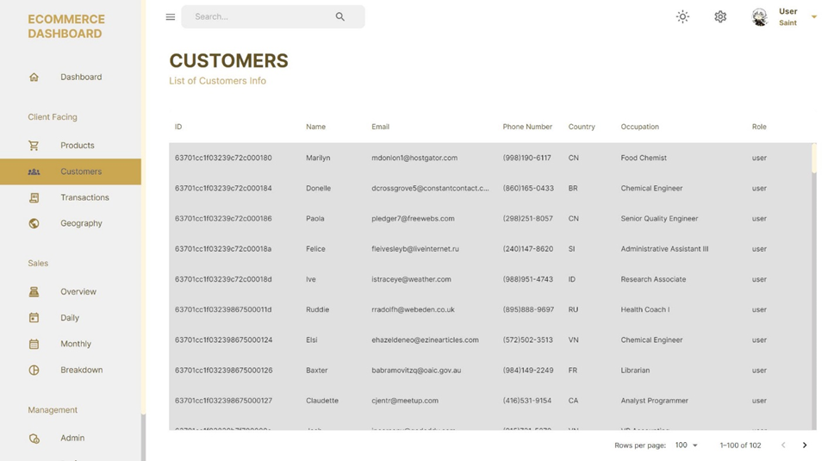
UI Design
Customers Page

Slide 22
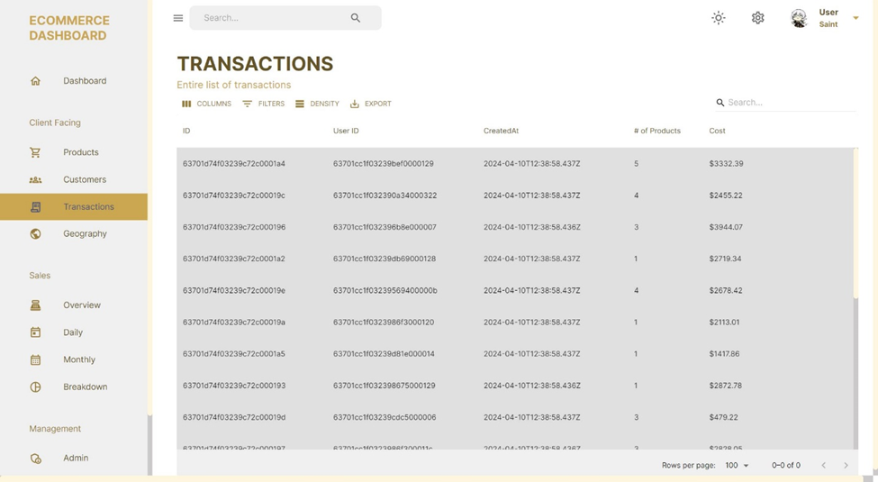
UI Design
Transactions Page

Slide 23
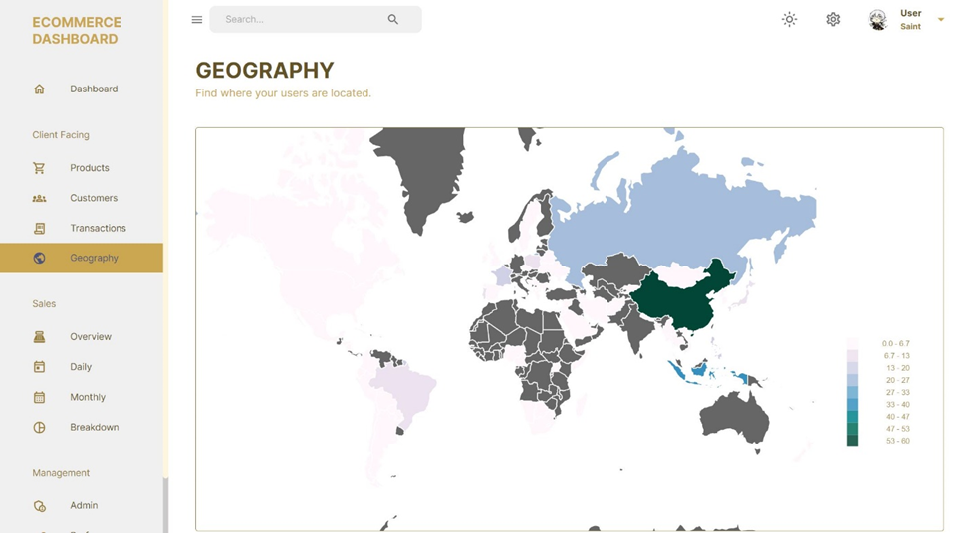
UI Design
Geography Page

Slide 24
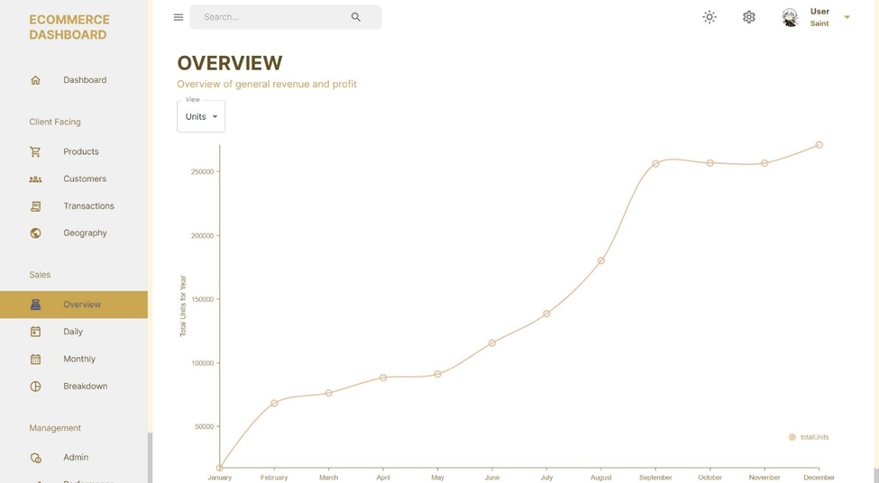
UI Design
Overview Page

Slide 25
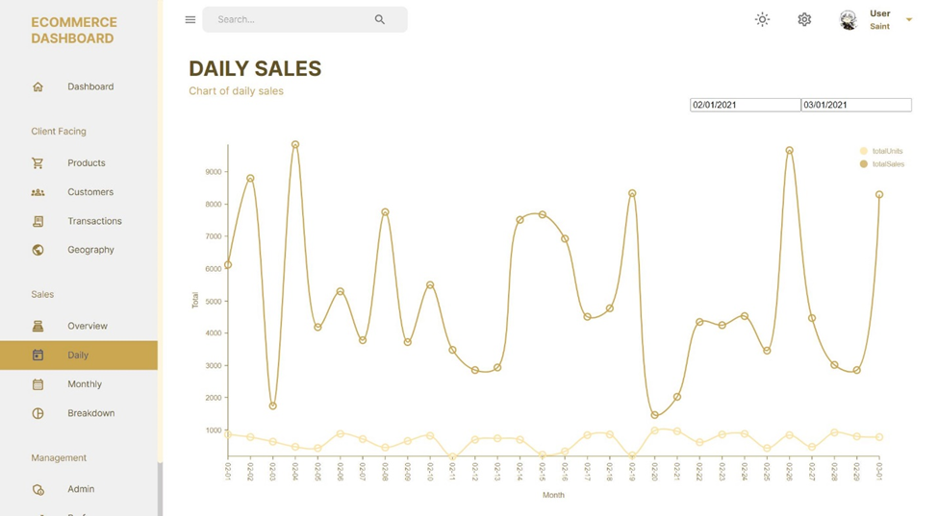
UI Design
Daily Page

Slide 26
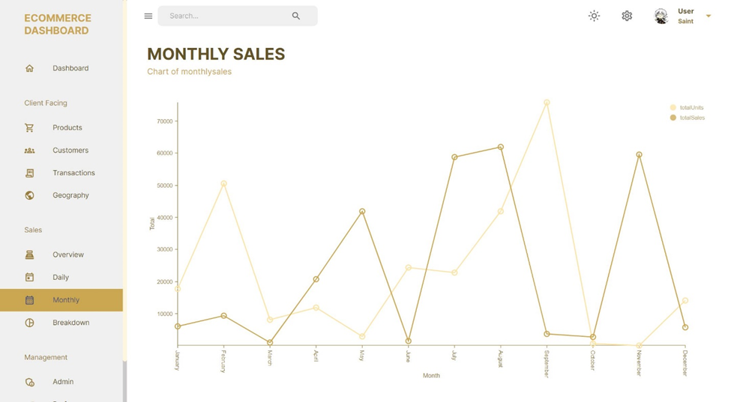
UI Design
Monthly Page

Slide 27
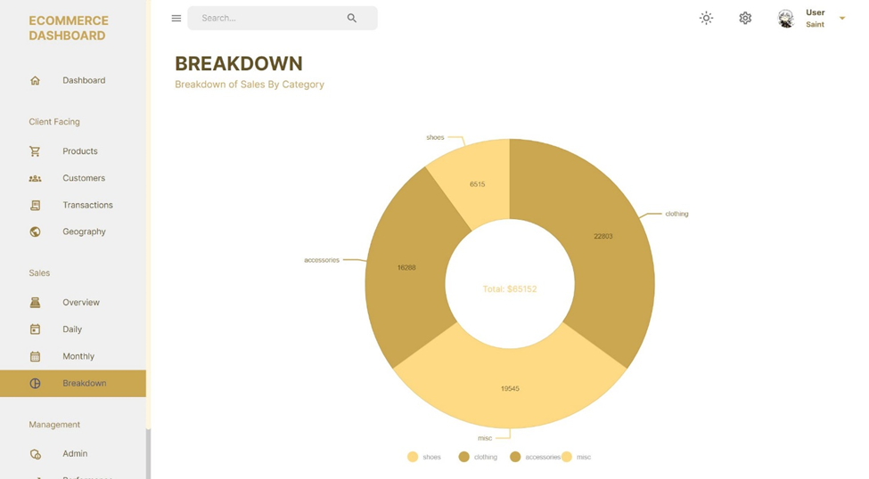
UI Design
Breakdown Page

Slide 28
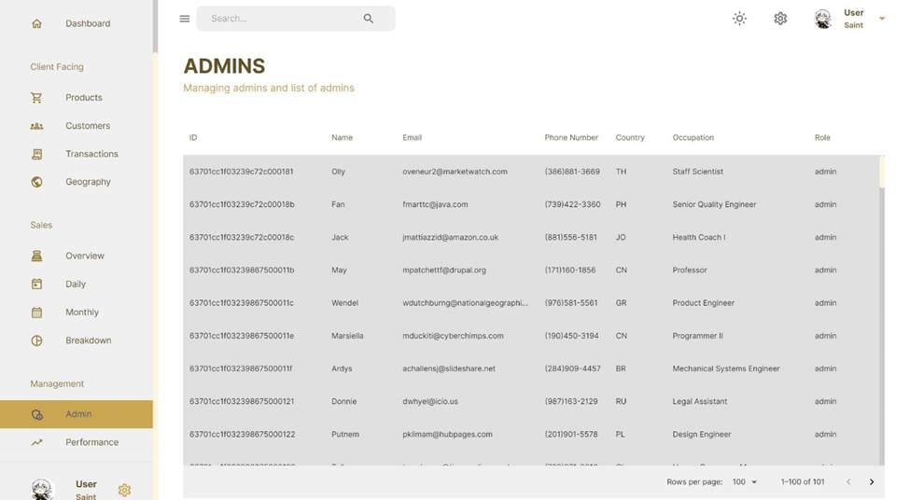
UI Design
Admin Page

Slide 29
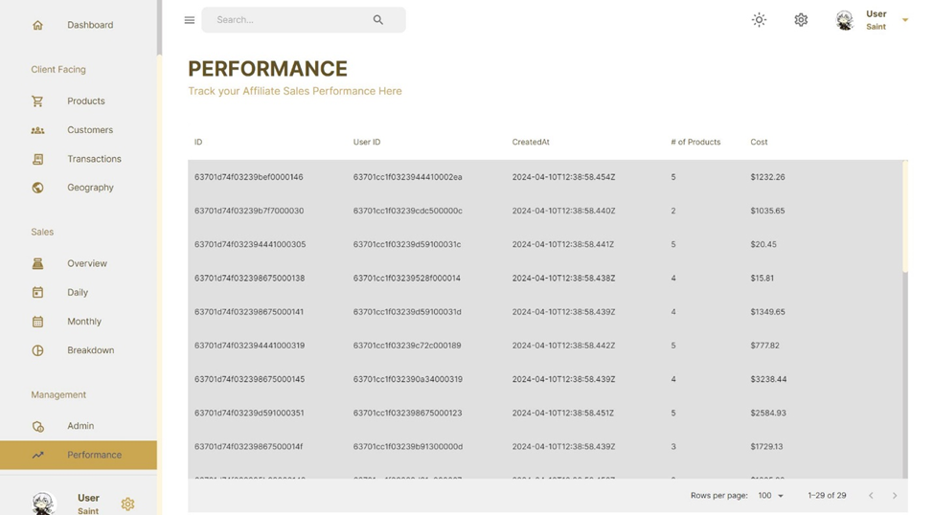
UI Design
Performance Page

Slide 30
Access the demo website in this link

Slide 31

QA Testing
Any systematic process used to determine if a product or service meets quality standards
Some simple functions in website is required for testing

Slide 32
QA Testing
Functions required for testing:
Dashboard page ‘Download Reports’ button to download the E-commerce Summary Report.
Products page ‘See More’ button to show the details of each products.
Overview page dropdown menu of showing ‘Unit’ graph or ‘Sales’ graph.
Daily page date picker tools for showing the sales of different time range.

Slide 33
Conclusion

Slide 34
Conclusion
E-commerce Dashboard brings paradigm shift in e-commerce management.
Empowers businesses to unlock actionable insights, streamline operations, and drive sustainable growth.
Navigate this landscape with confidence, well-prepared with the tools and intelligence needed to make informed decisions, capitalize on opportunities, and stay ahead of the curve

Slide 35
Linear Dashboard Infographics
71%
29%
56%
91%
Mercury
71%
Mercury is the closest planet to the Sun and the smallest one
Venus
29%
Venus has a beautiful name and is the second planet from the Sun
Mars
56%
Despite being red, Mars is actually a very cold place
Jupiter
91%
Jupiter is the biggest planet in the Solar System

Slide 36
Linear Dashboard Infographics
Well done!
Error
John Doe
Subtitle
Subtitle
Job description
+2
+1
+2
January
Su | Mo | Tu | We | Th | Fr | Sa
 |  |  | 1 | 2 | 3 | 4
5 | 6 | 7 | 8 | 9 | 10 | 11
12 | 13 | 14 | 15 | 16 | 17 | 18
19 | 20 | 21 | 22 | 23 | 24 | 25
26 | 27 | 28 | 29 | 30 | 31
Performance
January
25%
50%
February
March
April
75%
100%
Mercury
Button
42%
Mars
Button
78%
February
March
April
Jupiter
21%

Slide 37
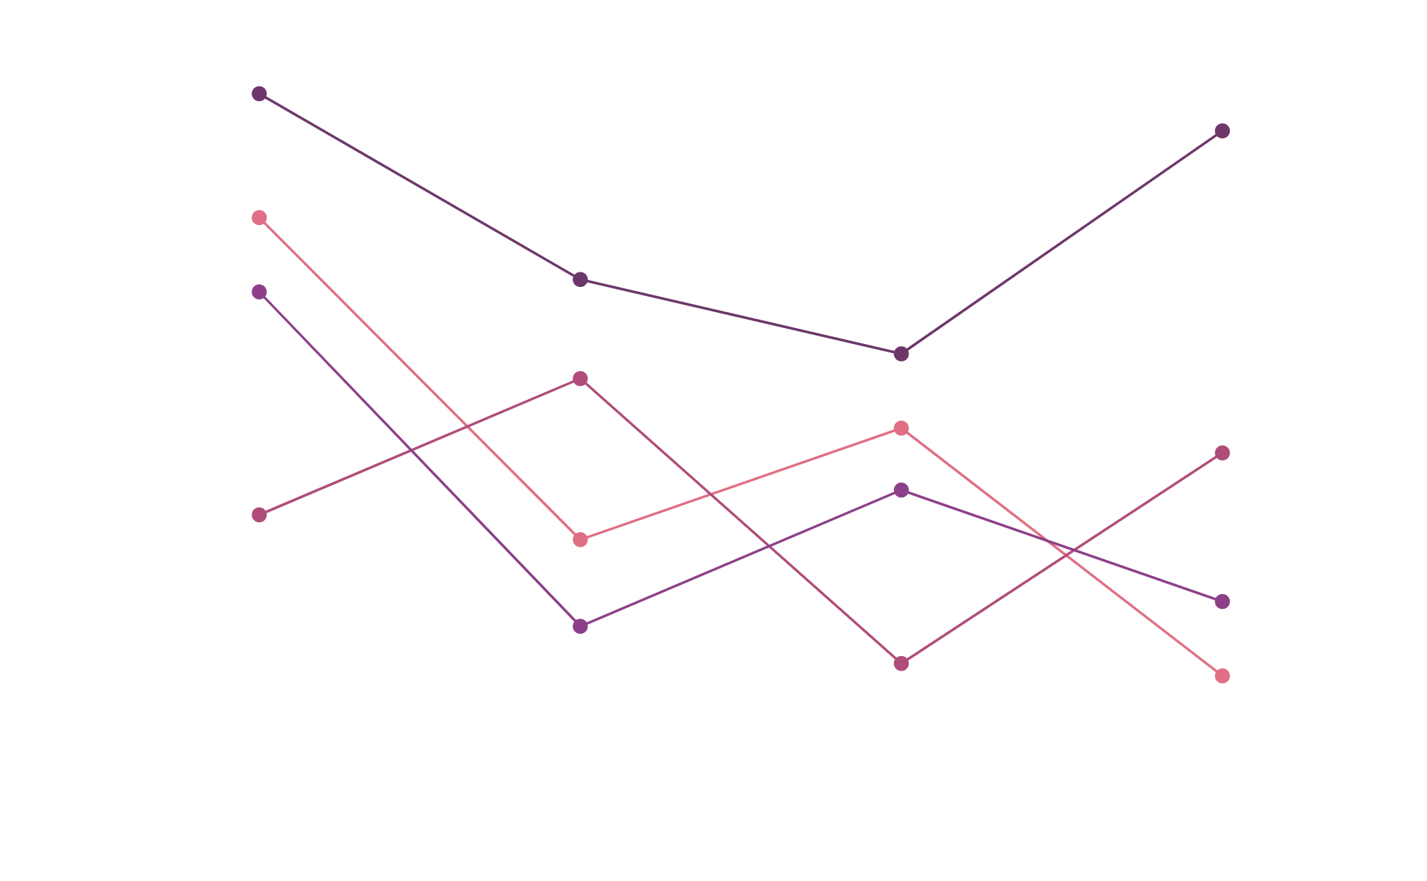
Linear Dashboard Infographics
Mercury
Venus
Mars
Neptune
5,789
3,965
1,678
4,834
Mercury is the smallest
Venus has a pretty name
Mars is a very cold place
Neptune is the farthest
Mercury
Venus
Mars
79%
Yes, planet Saturn is the ringed one and a gas giant
Neptune
To modify this graph, click on it, follow the link, change the data and paste the resulting graph here

Slide 38
Linear Dashboard Infographics
Sales
Income
Damage
$125,500
$246,301
$50,618
Mercury
Dashboard
Sales
My task
Mercury is the smallest planet
Calendar
Income
Portfolios
Despite being red, Mars is cold
Inbox
Damage
Work list
Jupiter is the biggest planet
Setting

Slide 39
Linear Dashboard Infographics
Follows
Income
Scope
Views
1.5K
521,400
50%
1M
Mercury is the smallest planet and closest to the Sun
Venus has a beautiful name and is the second planet from the Sun
Despite being red, Mars is actually a very cold place
Jupiter is the biggest planet in the Solar System and a gas giant

Slide 40
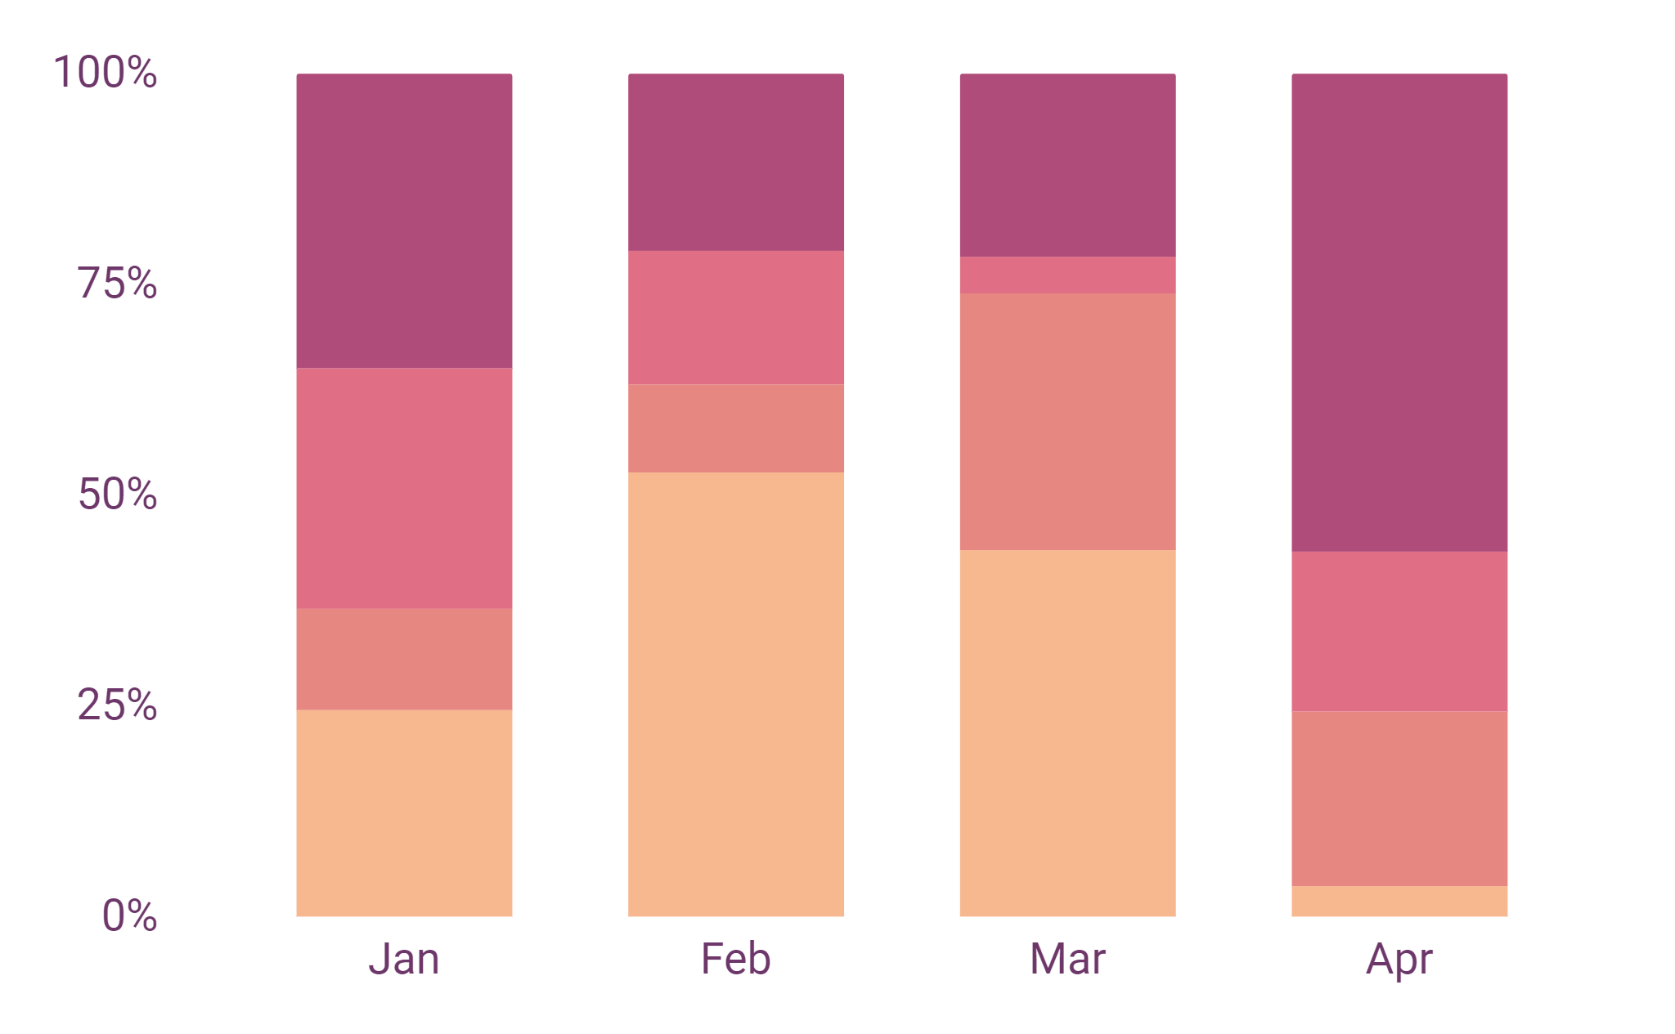
Linear Dashboard Infographics
$23,750
Subtitle
Mercury
Mars
2,750
Mercury is the closest planet to the Sun
Despite being red, Mars is a cold place
Subtitle
Venus
Jupiter
70%
Venus has a beautiful name, but it’s hot
Jupiter is the biggest planet of them all
Mercury
To modify this graph, click on it, follow the link, change the data and paste the resulting graph here
Mercury is the closest planet

Slide 41
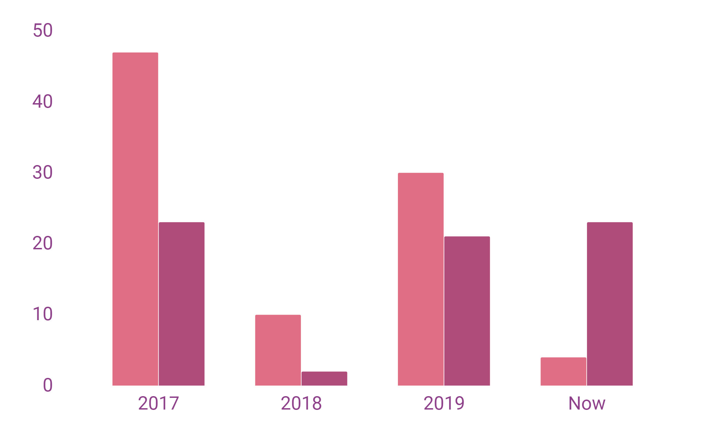
Linear Dashboard Infographics
Mercury
Mercury is the smallest planet
Venus
Venus has a beautiful name
63%
87%
2017
Mercury is the smallest planet
2018
Venus has a beautiful name
2019
Despite being red, Mars is cold
Now
Jupiter is the biggest planet
To modify this graph, click on it, follow the link, change the data and paste the resulting graph here

Slide 42
Linear Dashboard Infographics
01
Mercury is the closest to the Sun
03
Despite being red, Mars is cold
02
Venus has a pretty name, but it’s hot
04
Saturn is the ringed one and a gas giant
 | January | February | March | April | May
Phase 1
Task 1
Task 2

Slide 43
Linear Dashboard Infographics
Evolution
January
Su | Mo | Tu | We | Th | Fr | Sa
 |  |  | 1 | 2 | 3 | 4
5 | 6 | 7 | 8 | 9 | 10 | 11
12 | 13 | 14 | 15 | 16 | 17 | 18
19 | 20 | 21 | 22 | 23 | 24 | 25
26 | 27 | 28 | 29 | 30 | 31
42%
28%
74%
63%
Mercury
Project A
$21,456
Mercury is the closest planet to the Sun and the smallest
Project B
$57,503

Slide 44
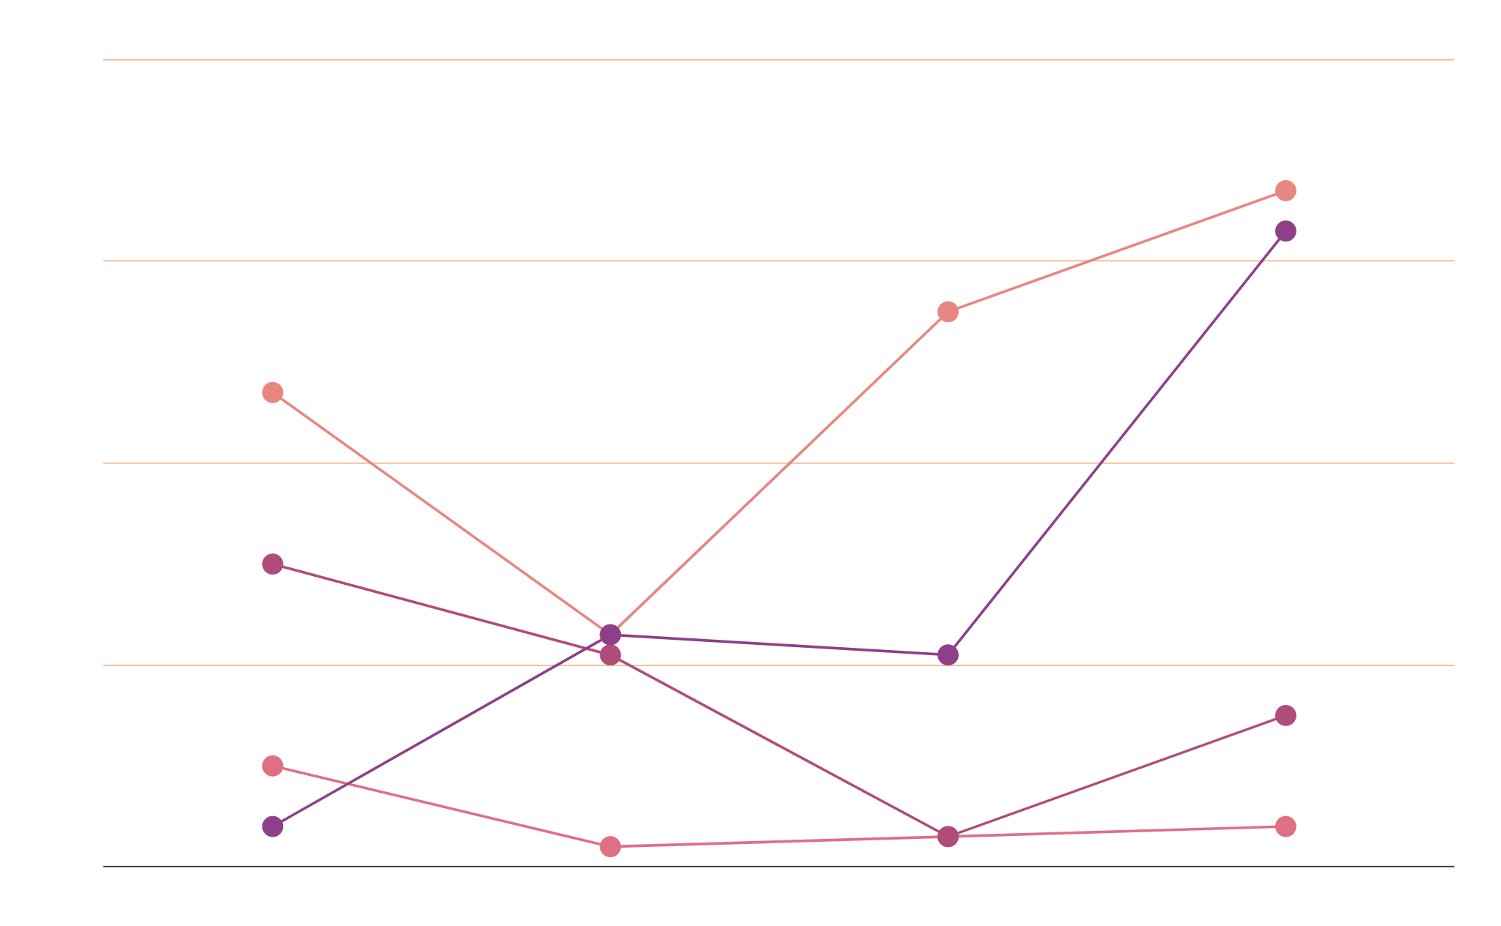
Linear Dashboard Infographics
Mercury 81%
Mars
Mars 76%
56%
Jupiter 62%
Jupiter
Saturn 46%
38%
Mercury is the closest
Charts
Mars is a cold place
Jupiter is the biggest
Saturn is the ringed
21%
64%
83%
49%
To modify this graph, click on it, follow the link, change the data and paste the resulting graph here

Slide 45
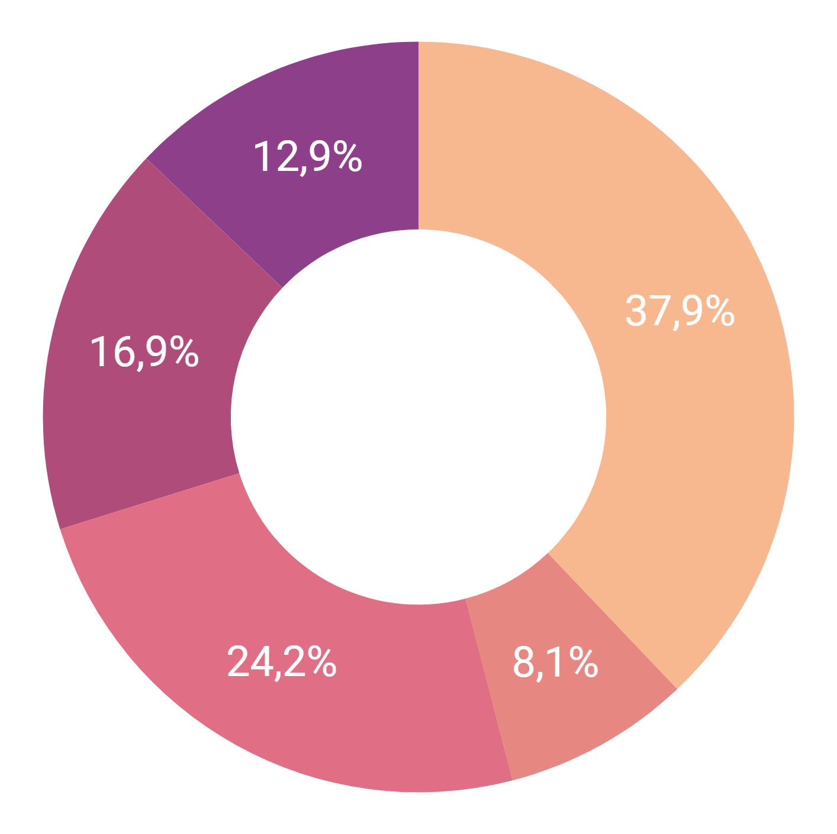
Linear Dashboard Infographics
Total
Views
Users
Shares
Favs
1,560,184
213,648
7,592
2,801
8,476
Mercury is the closest planet to the Sun and the smallest
Chart
Venus has a beautiful name and is the second planet from the Sun
Despite being red, Mars is a cold place. It’s full of oxide dust
Jupiter is the biggest planet in the Solar System. It’s a gas giant
Yes, Saturn is the ringed one. It’s composed of hydrogen and helium
93%
81%
24%
To modify this graph, click on it, follow the link, change the data and paste the resulting graph here

Slide 46
Linear Dashboard Infographics
Social media
62%
48%
Neptune is the farthest planet
62%
48%
79%
93%
Mercury
Venus
Mercury is the smallest planet
Venus has a beautiful name
79%
93%
Mars
Jupiter
Mars is a very cold place
Jupiter is the biggest planet

Slide 47
Linear Dashboard Infographics
68%
Mercury is the closest planet to the Sun and the smallest
86%
Jupiter is the biggest planet in the Solar System. It’s a gas giant
Name | Date | Task | Amount | Edit | More
John Doe | 09/01/2020 | Design | $1,529
Jane Doe | 21/01/2020 | SEO | $1,529
John Doe | 03/02/2020 | Coding | $1,529
Jane Doe | 15/02/2020 | Design | $1,529
John Doe | 26/02/2020 | SEO | $1,529
Venus has a beautiful name
Mars is a very cold place

Slide 48
Linear Dashboard Infographics
Jupiter
$9,500
70%
48%
Jupiter is the biggest planet of them all
Neptune
$13,625
Neptune is the farthest from the Sun
Mercury is the smallest planet
Saturn is the ringed planet
Venus
$18,750
Venus has a beautiful name, but it’s very hot
Mercury
Saturn
Mars
$10,285
5,603
7,431
Despite being red, Mars is a cold place
It’s the smallest
It has rings

Slide 49
Linear Dashboard Infographics
Mercury is the closest planet to the Sun and the smallest
Mars is actually a cold place. It’s full of iron oxide dust
2017
2018
Now
2019
Venus has a pretty name and is the second planet from the Sun
Neptune is the farthest planet from the Sun
Jupiter is the biggest in the Solar System. It’s a gas giant
2017
2018
2019
Now
75%
65%
25%
35%

Slide 50
Linear Dashboard Infographics
Jupiter
Mars
56%
Jupiter
Jupiter is the biggest planet
Mars is a very cold place
33%
Mars
78%
Neptune
Neptune
Saturn
Neptune is the farthest planet
Saturn is the ringed one
21%
Saturn

Slide 51
Linear Dashboard Infographics
Mercury is the closest planet to the Sun and the smallest
Venus has a beautiful name and is the second planet from the Sun
Despite being red, Mars is a cold place. It’s full of oxide dust
30%
80%
91%
$ 2,114
$ 1,591
$4,817

Slide 52
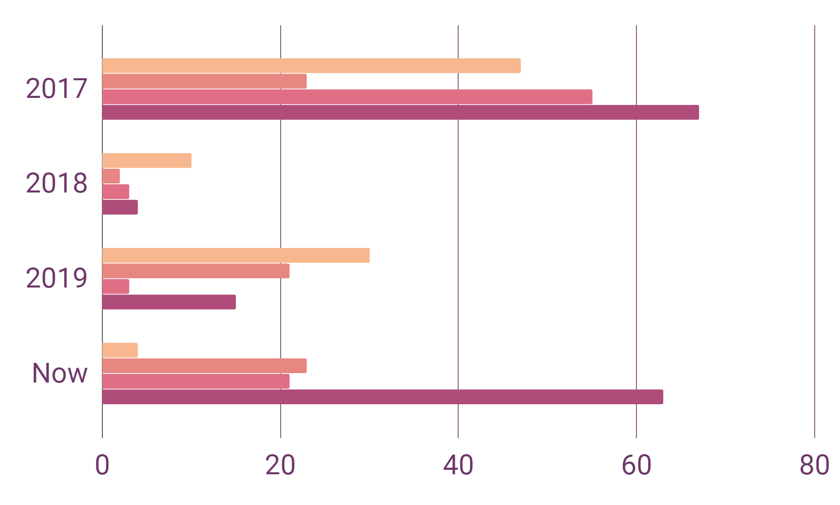
Linear Dashboard Infographics
Mars
Mercury
Despite being red, Mars is a cold place
Mercury is the closest planet to the Sun
Venus
Jupiter
Venus has a beautiful name, but it’s very hot
Jupiter is the biggest planet in the Solar System
To modify this graph, click on it, follow the link, change the data and paste the resulting graph here
2017
$12,637
It’s the smallest planet
2019
$24,791
We live on Earth
2018
$18,150
It’s full of iron oxide dust
Now
$40,625
It’s the fifth from the Sun

Slide 53
Linear Dashboard Infographics
Mercury
Mars
Venus
Jupiter
Saturn
Neptune
Mars is a very cold place
Jupiter is the biggest planet
Mercury is the smallest planet
Saturn is the ringed planet
$2,791
$3,678
$1,869
$2,018
$5,864
$7,019
Venus has a beautiful name
Neptune is the farthest planet

Slide 54
Linear Dashboard Infographics
January
Su | Mo | Tu | We | Th | Fr | Sa
 |  |  | 1 | 2 | 3 | 4
5 | 6 | 7 | 8 | 9 | 10 | 11
12 | 13 | 14 | 15 | 16 | 17 | 18
19 | 20 | 21 | 22 | 23 | 24 | 25
26 | 27 | 28 | 29 | 30 | 31
71%
Mercury
Mercury is the smallest planet
87%
Jupiter
Jupiter is the biggest planet
71%
87%

Slide 55
Linear Dashboard Infographics
Mars
Neptune
$3,408,572
$1,034,849
Mercury
Venus
Saturn
Mars
Jupiter
Neptune
Mercury is a small planet
Venus has beautiful name
Saturn is the ringed one
Mars is a cold place
Jupiter is the biggest planet
Neptune is the farthest

Slide 56
Linear Dashboard Infographics
Mercury is the closest planet to the Sun and the smallest
Despite being red, Mars is actually a very cold place
Venus
Saturn
It’s the first planet
It’s the ringed one
Venus
48%
Saturn
72%
It’s a bit larger than the Moon
Mars is full of iron oxide dust

Slide 57
Linear Dashboard Infographics
Mars
Mercury
Venus
Jupiter
Despite being red, Mars is cold
Mercury is the smallest planet
Venus has a beautiful name
Jupiter is the biggest planet
75%
70%
It’s full of iron oxide dust
60%
It’s the smallest planet
60%
75%
40%
Venus is terribly hot
Jupiter is a gas giant
40%
70%

Slide 58
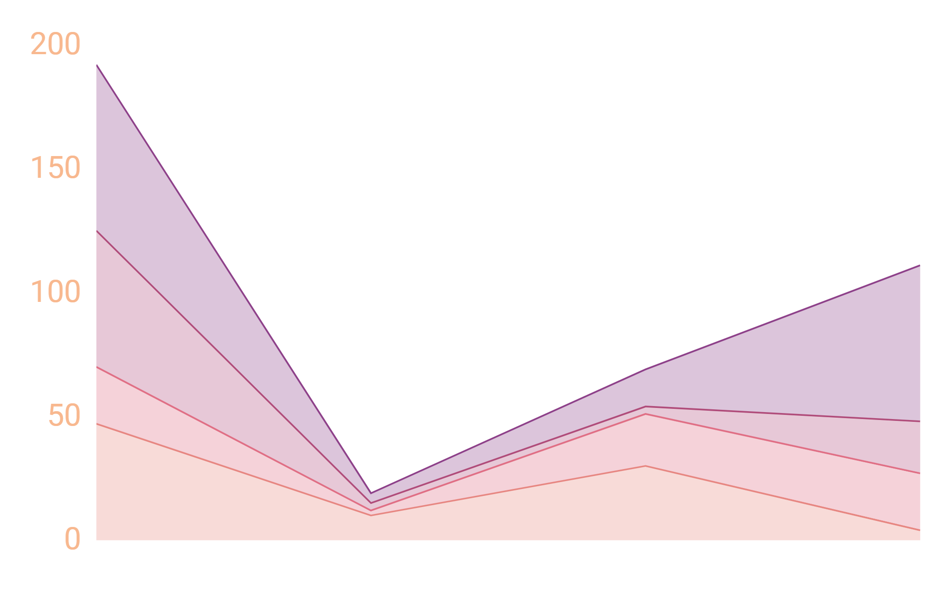
Linear Dashboard Infographics
75%
36%
82%
94%
Mercury
Mars
Mercury is the closest planet to the Sun
Despite being red, Mars is actually a very cold place
Venus
Jupiter
Venus has a beautiful name, but it’s terribly hot
Jupiter is the biggest planet in the Solar System
To modify this graph, click on it, follow the link, change the data and paste the resulting graph here

Slide 59
Linear Dashboard Infographics
35,000
30,000
Mercury
Mercury is the closest to the Sun
25,000
Mars
Despite being red, Mars is cold
20,000
Venus
Venus has a beautiful name
15,000
10,000
Jupiter
Jupiter is the biggest planet
0
71%
53%
36%
92%
84%

Slide 60
Linear Dashboard Infographics
Mercury is a small planet
Neptune is the farthest
$97,385
Mars is a very cold place
Saturn is the ringed one
$83,241
Venus has a beautiful name
Jupiter is the biggest planet
$63,917
$45,416
Mercury
Neptune
$36,079
Mars
Saturn
$21,490
Venus
Jupiter

Slide 61
Linear Dashboard Infographics
01
02
03
04
Mercury
Mars
Venus
Jupiter
January
Su | Mo | Tu | We | Th | Fr | Sa
 |  |  | 1 | 2 | 3 | 4
5 | 6 | 7 | 8 | 9 | 10 | 11
12 | 13 | 14 | 15 | 16 | 17 | 18
19 | 20 | 21 | 22 | 23 | 24 | 25
26 | 27 | 28 | 29 | 30 | 31
Mercury is the smallest planet
$21,406
Mars is actually a cold place
$43,941
Venus has a beautiful name
$81,492
Jupiter is the biggest planet
$106,813

Slide 62
Linear Dashboard Infographics
Mercury
Mercury is the closest planet to the Sun and the smallest one in the Solar System
Mars
Despite being red, Mars is actually a cold place. It’s full of iron oxide dust
Venus
Venus has a beautiful name, but it’s terribly hot. Its atmosphere is poisonous
Jupiter
Jupiter is the biggest planet in the Solar System. It’s the fourth-brightest object
78%
64%
50%
37%

Slide 63
Instructions for use (free users)
In order to use this template, you must credit Slidesgo by keeping the Thanks slide.
You are allowed to:
Modify this template.
Use it for both personal and commercial purposes.
You are not allowed to:
Sublicense, sell or rent any of Slidesgo Content (or a modified version of Slidesgo Content).
Distribute this Slidesgo Template (or a modified version of this Slidesgo Template) or include it in a database or in any other product or service that offers downloadable images, icons or presentations that may be subject to distribution or resale.
Use any of the elements that are part of this Slidesgo Template in an isolated and separated way from this Template.
Delete the “Thanks” or “Credits” slide.
Register any of the elements that are part of this template as a trademark or logo, or register it as a work in an intellectual property registry or similar.
For more information about editing slides, please read our FAQs or visit Slidesgo School:
https://slidesgo.com/faqs and https://slidesgo.com/slidesgo-school

Slide 64
Instructions for use (premium users)
In order to use this template, you must be a Premium user on Slidesgo.
You are allowed to:
Modify this template.
Use it for both personal and commercial purposes.
Hide or delete the “Thanks” slide and the mention to Slidesgo in the credits.
Share this template in an editable format with people who are not part of your team.
You are not allowed to:
Sublicense, sell or rent this Slidesgo Template (or a modified version of this Slidesgo Template).
Distribute this Slidesgo Template (or a modified version of this Slidesgo Template) or include it in a database or in any other product or service that offers downloadable images, icons or presentations that may be subject to distribution or resale.
Use any of the elements that are part of this Slidesgo Template in an isolated and separated way from this Template.
Register any of the elements that are part of this template as a trademark or logo, or register it as a work in an intellectual property registry or similar.
For more information about editing slides, please read our FAQs or visit Slidesgo School:
https://slidesgo.com/faqs and https://slidesgo.com/slidesgo-school

Slide 65
Infographics
You can add and edit some infographics to your presentation to show your data in a visual way.
Choose your favourite infographic and insert it in your presentation using Ctrl C + Ctrl V or Cmd C + Cmd V in Mac.
Select one of the parts and ungroup it by right-clicking and choosing “Ungroup”.
Change the color by clicking on the paint bucket.
Then resize the element by clicking and dragging one of the square-shaped points of its bounding box (the cursor should look like a double-headed arrow). Remember to hold Shift while dragging to keep the proportions.
Group the elements again by selecting them, right-clicking and choosing “Group”.
Repeat the steps above with the other parts and when you’re done editing, copy the end result and paste it into your presentation.
Remember to choose the “Keep source formatting” option so that it keeps the design. For more info, please visit Slidesgo School.

